Slide 1
Module 2 – Leadership
Chapter 2 – Qualities of a Leader
Section 1 – Qualities of a Leader

Slide 2
Demonstrate knowledge of the challenge of leadership, the qualities of an effective leader, how to evaluate the performance of subordinates and how to give instruction

Slide 3
Differentiate between moral responsibility and legally enforceable laws
Define loyalty
Describe devotion to duty
Describe professional knowledge and experience
Explain the importance of self-confidence

Slide 4
Key Term Questions Slide Index
Click any link below to go directly to polling that question.
Mental and moral qualities distinctive to individual
Faithful devotion to country, organization, and associates
Trust in one’s abilities, qualities, and judgment
Insulting way of thinking that comes from believing that you are better than other people
Opportunity to act before others do
Click here to return to this index.

Slide 5
Team Assignment
Alpha
Bravo
Charlie
Delta

Slide 6
The mental and moral qualities distinctive to an individual
Self-confidence
Loyalty
Character
Arrogance
1
1
1
1
NS3-M2U1C2S1:KT1

Slide 7
Faithful and enthusiastic devotion to one’s country, organization, and associates
Arrogance
Loyalty
Character
Initiative
1
1
1
1
NS3-M2U1C2S1:KT2

Slide 8
A feeling of trust in one’s abilities, qualities, and judgment
Character
Self-confidence
Arrogance
Loyalty
1
1
1
1
NS3-M2U1C2S1:KT3

Slide 9
An insulting way of thinking or behaving that comes from believing that you are better, smarter, or more important than other people
Arrogance
Initiative
Character
Loyalty
1
1
1
1
NS3-M2U1C2S1:KT4

Slide 10
The opportunity to act or take charge before others do
Apathy
Moxie
Arrogance
Initiative
1
1
1
1
NS3-M2U1C2S1:KT5

Slide 11
Character -
The mental and moral qualities distinctive to an individual
Loyalty -
Faithful and enthusiastic devotion to one’s country, organization and associates
Self-confidence -
A feeling of trust in one’s abilities, qualities, and judgment

Slide 12
Arrogance -
An insulting way of thinking or behaving that comes from believing that you are better, smarter, or more important than other people
Initiative -
The opportunity to act or take charge before others do

Slide 13
Name and discuss qualities that are necessary to be a leader.
1.
2.
3.
Note to Instructors:
Click the Show/Hide Response Display Button

Slide 14
How would you rank your knowledge level in the qualities of an effective leader?
Expert - I have studied up on leadership qualities and styles.
Moderate - I could hold a discussion.
Novice – I’m sure different qualities exist.
Zilch - I have lot to learn to be a good leader.
1
1
1
1
NS3-M2U1C2S1:LQ1

Slide 15
Which of the following are essential qualities of leadership? (Input all that apply, then push the ENTER button.)
Vanity
Honor
Courage
Loyalty
Self-confidence
1
1
1
1
1
NS3-M2U1C2S1:LQ2

Slide 16
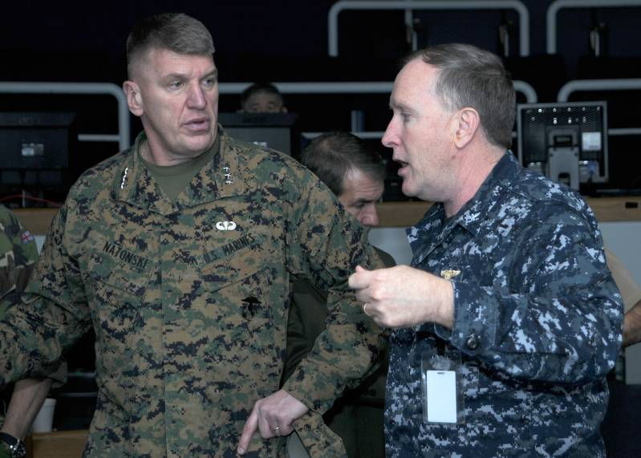
Introduction
No Two Leaders are Alike
Not all leaders possess the:
Same traits
Same ways of accomplishing goals
Same qualities
Great leaders possess certain characteristics and abilities.
It is important to know the qualities needed to be an effective leader.

Slide 17
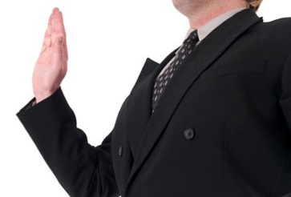
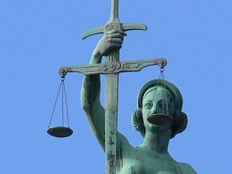
Moral Responsibility
A high sense of moral responsibility and personal code of conduct is one of the most important leadership characteristics.
Each person must establish and enforce their own moral law and code of conduct.

Slide 18
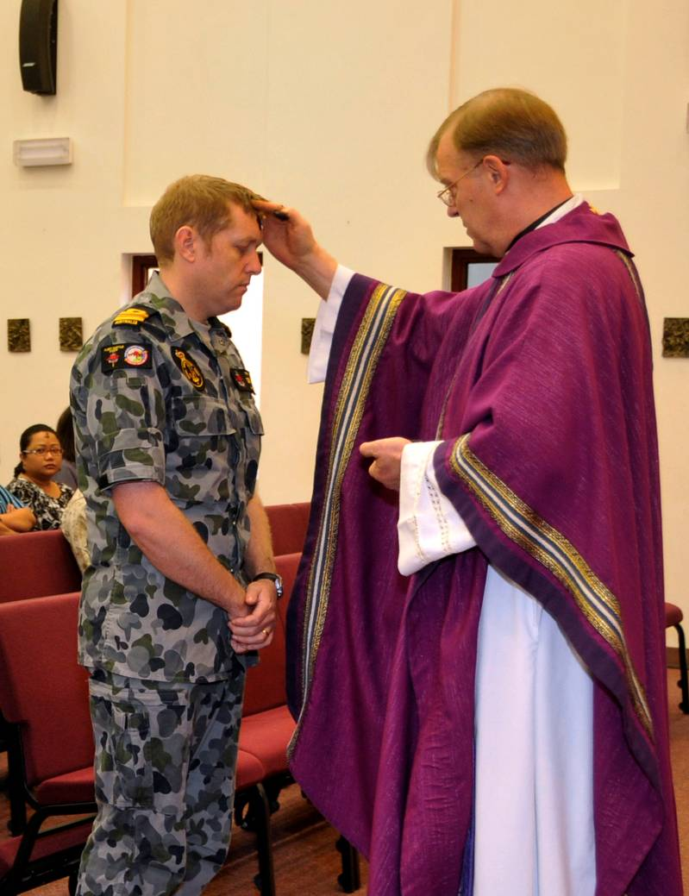
Moral Responsibility
Personal Codes of Conduct
Great leaders have strong personal codes of conduct that do not permit them to:
Take unfair advantage of citizens or subordinates
Misuse their positions for personal gain

Slide 19
Moral Responsibility
Moral Laws
Moral laws are difficult to define because:
Most moral laws cannot be legally enforced
Each person’s level of perceived moral responsibility differs
Individual conscience is the enforcer

Slide 20
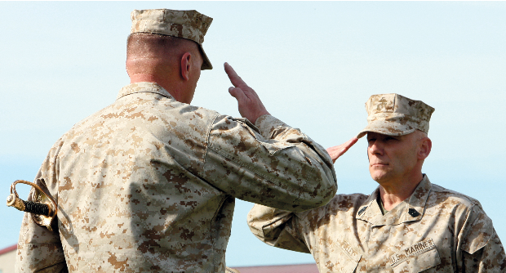
Loyalty
Loyalty means faithful and enthusiastic devotion to one’s country, organization, and associates.
In the military, loyalty must be broadened to include one’s superiors and subordinates.

Slide 21
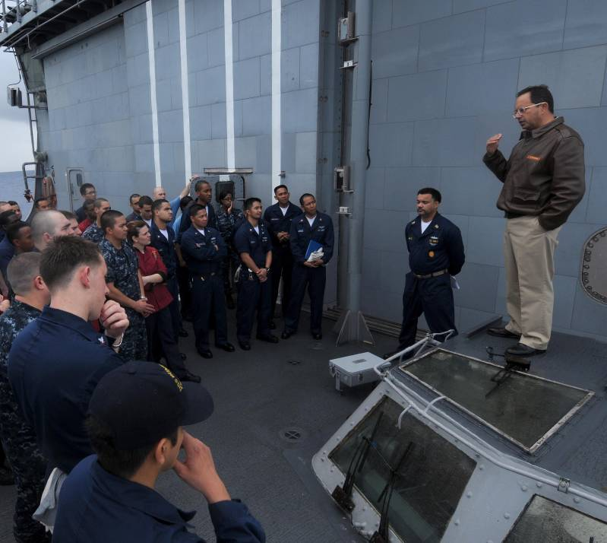
Loyalty
Facts about loyalty:
Must be earned
Is a two-way street
Is easily noticed when absent
Effects morale
May cause others to do more or less to accomplish a mission

Slide 22
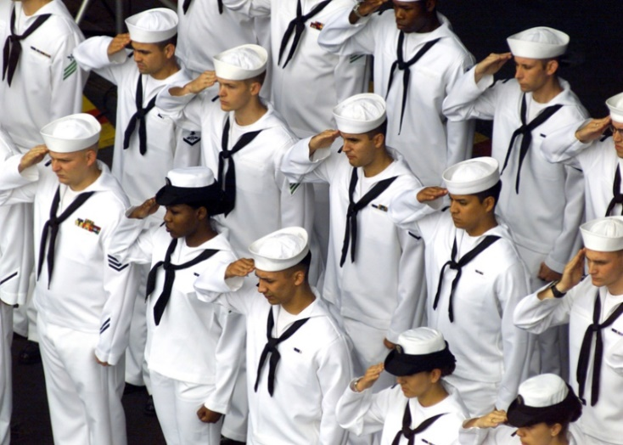
Devotion to Duty
Devotion to duty means loyalty to the position or job one holds.
Devotion is shown by:
Exerting maximum effort on present job
Taking initiative to learn tasks and billets demanding greater responsibility

Slide 23
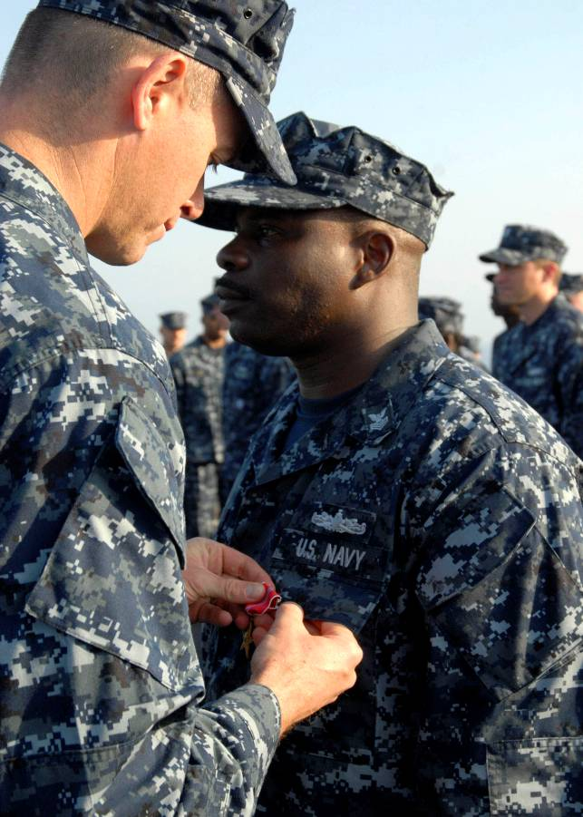
Devotion to Duty
Devotion to duty leads to:
Positive recommendations
Advancements
Promotions

Slide 24
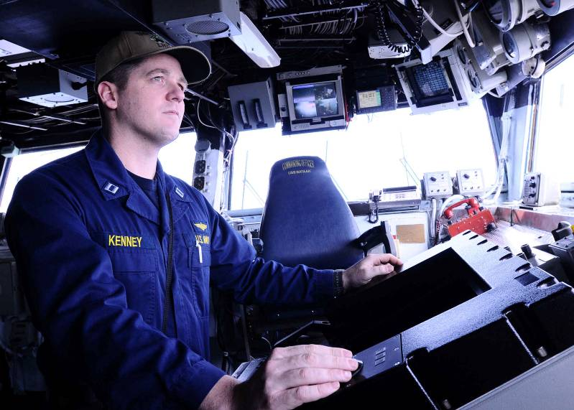
Devotion to Duty
Ambition is not Enough
All military personnel are expected to:
Place duty above self
Always perform to best of abilities
Why? This is the best way to:
Accomplish the mission
Prevent mission failure

Slide 25
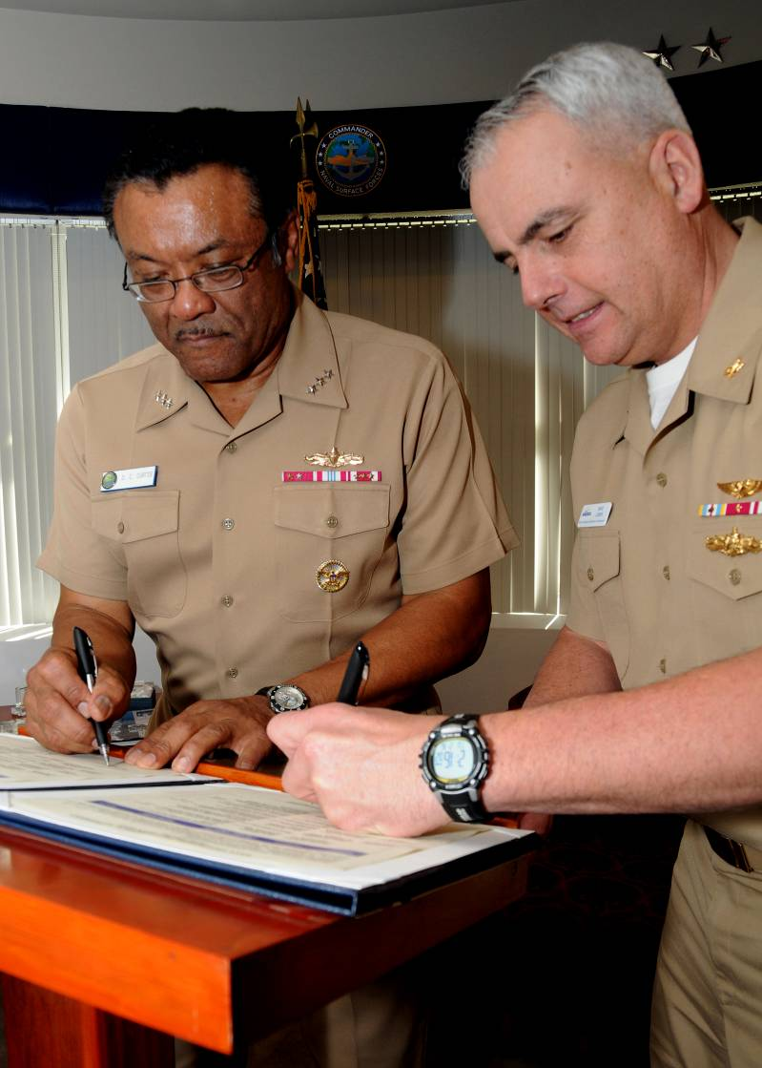
Professional Knowledge
Book Smarts is not Enough
Experience is essential. Do the following to gain knowledge and experience:
Call upon more experienced people to assist whenever needed
Learn as much as possible from prior leader when replacing a leader

Slide 26
Professional Knowledge
New Leaders Listen
New leaders motivate others by:
Showing interest in learning from their experience – subordinates will be eager to help
Listen to advice and suggestions from the person being relieved

Slide 27
What is one of the most important leadership characteristics?
A high sense of moral responsibility and personal code of conduct
Possessing the same traits as fellow leaders
Displaying arrogance sparingly to earn loyalty
Placing self above duty
1
1
1
1
NS3-M2U1C2S1:LQ3

Slide 28
Which of the following statements are true about loyalty? (Input all that apply, then push the ENTER button.)
Loyalty is easily noticed when absent.
Loyalty is not related to morale.
Loyalty may cause others to do more or less.
Loyalty must be earned.
Loyalty is a one-way street.
1
1
1
1
1
NS3-M2U1C2S1:LQ4

Slide 29
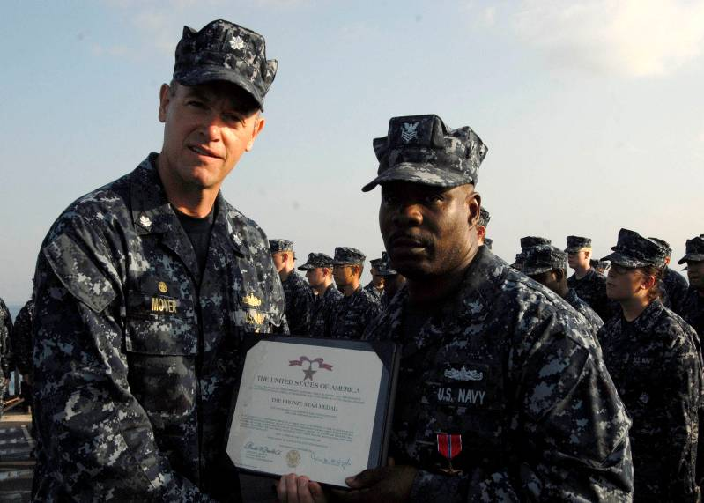
Self-Confidence
Self-confidence is one of the most important qualities of leadership. It is increased by increasing knowledge.
Past accomplishments and educational degrees by themselves are not sufficient.
Proven ability on the job is a basic requirement.

Slide 30
Self-Confidence
Inexperienced Leader’s Mistakes
Arrogance = Loss of Respect
Loss of Respect = More Difficult Job

Slide 31
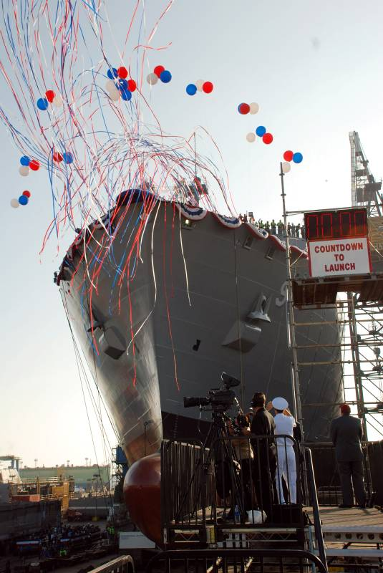
Initiative and Ingenuity
Initiative and Ingenuity are Desired
Showing initiative and ingenuity is possible in the military services.
The need for initiative and ingenuity is greater than ever because of new things such as:
Ships
Equipment
Weapons
Concepts of warfare

Slide 32
Initiative and Ingenuity
Gain Self-Confidence by:
Preparing yourself by taking advantage of everyday opportunities
Not forgetting the importance of background knowledge to problem-solving
Trying to be aware of what has already been tried
Not wasting time and effort by reinventing the wheel

Slide 33
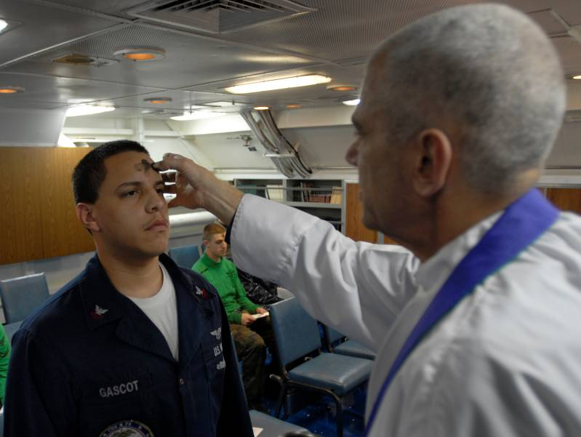
Courage
Courage is the quality enables us to accept our responsibilities and to carry them out regardless of the consequences.
It would be difficult to imagine a true leader who did not possess courage.

Slide 34
Courage
A Courageous Person
A courageous person:
Meets dangers and difficulties with firmness
Conquers inner fears
Concentrates on the task at hand
Develops and strengthens courage over time by using it to overcome obstacles
Accepts disappointment, but tries again to succeed

Slide 35
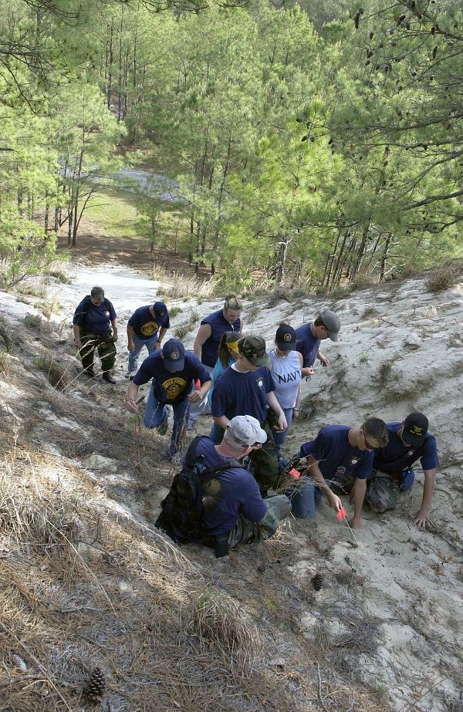
Courage
Developing Courage
Courage develops and strengthens over time by:
Overcoming obstacles
Accepting disappointment of failure, but striving again for success

Slide 36
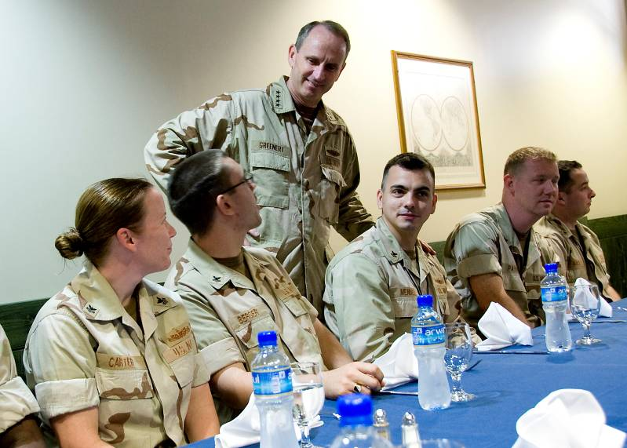
Moral Courage
Moral courage is a show of firmness in difficult situations where the danger of death or injury is not an immediate concern.

Slide 37
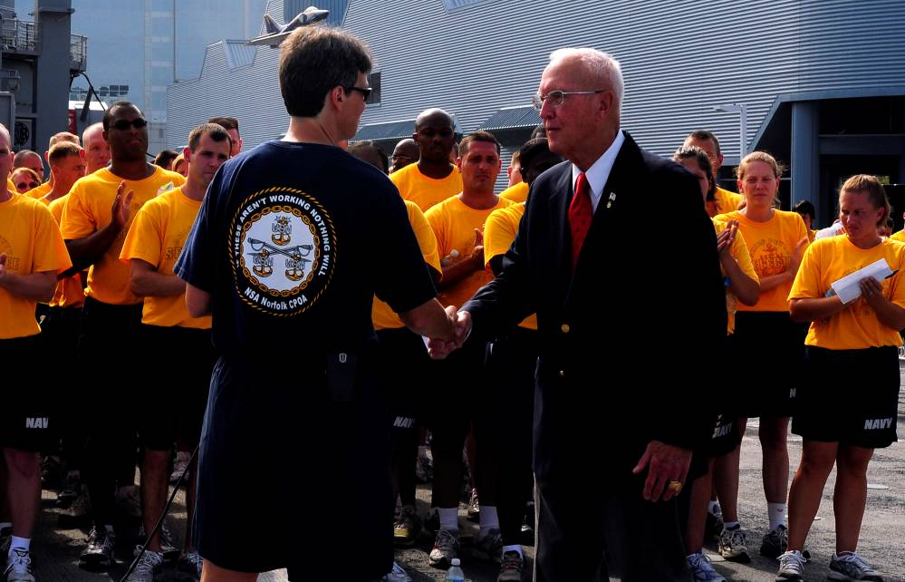
Moral Courage
Moral Courage is Difficult
Examples of pressures that make moral courage difficult include:
Fear of anger from seniors
Fear of ridicule by peers
Lack of confidence due to immaturity
Ignorance

Slide 38
Moral Courage
Why moral courage is important:
It is necessary to ensure that seniors get the information they need to make good decisions
People who say nothing, or agree with seniors and then criticize them behind their backs, lose both the respect of juniors and the trust of seniors
Leaders who show respect for the opinions of others, especially subordinates, are admired and respected for having moral courage

Slide 39
Moral Courage
It takes moral courage to:
Admit mistakes
Be honest, just, and truthful at all times
Insist on abiding by regulations and laws
Stick to high principles in the face of ridicule by peers

Slide 40
Arrogance leads to
increased respect.
a more difficult job.
greater loyalty.
less subordination.
1
1
1
1
NS3-M2U1C2S1:LQ5

Slide 41
Which of the following has the most direct positive correlation with self-confidence?
Knowledge and experience
Past accomplishments
Educational degree
Rank
1
1
1
1
NS3-M2U1C2S1:LQ6

Slide 42
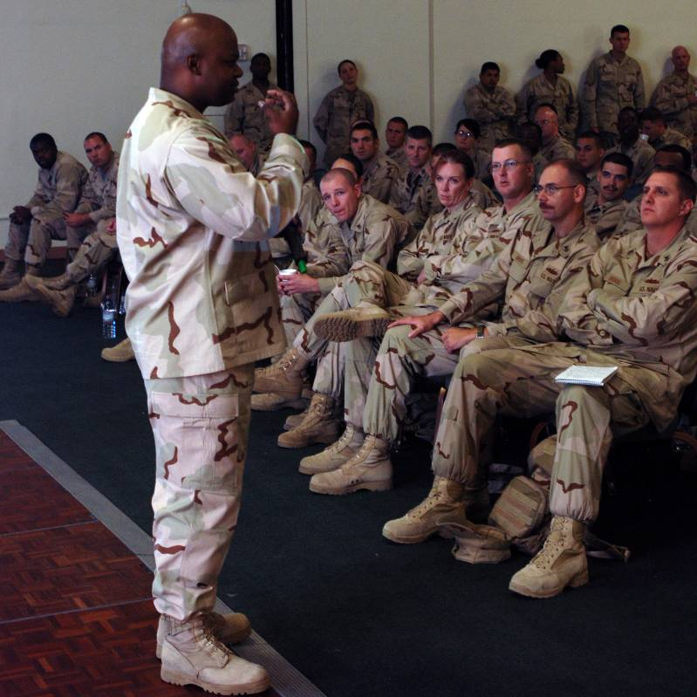
Ability to Organize and Make Decisions
Main Job of a Leader
The main job of a leader is to coordinate the efforts of personnel to achieve a common purpose.

Slide 43
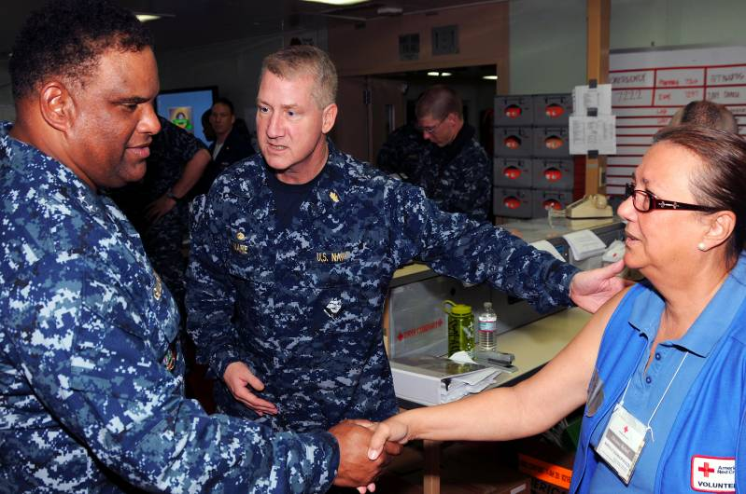
Ability to Organize and Make Decisions
Making Final Decisions
Without the ability to make good decisions, a leader is useless.
Before you make decisions, be fully aware of the skills and capabilities of assigned personnel.

Slide 44
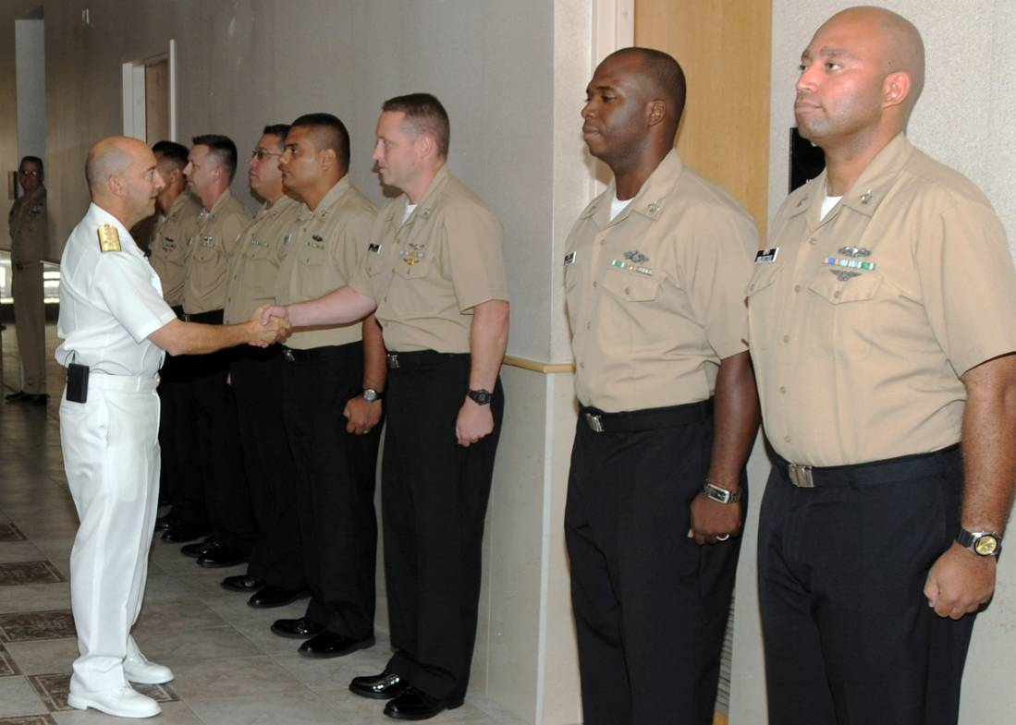
Ability to Organize and Make Decisions
What Subordinates Expect
Subordinates expect clear-cut decisions about various types of problems:
Personal
Professional
Complex

Slide 45
Ability to Organize and Make Decisions
Experience and Mistakes
When needed, discuss problems with your superior, especially those problems that are beyond your level of authority.
Accept that mistakes will happen and that they are learning opportunities.
From mistakes comes experience, and from experience comes wisdom.

Slide 46
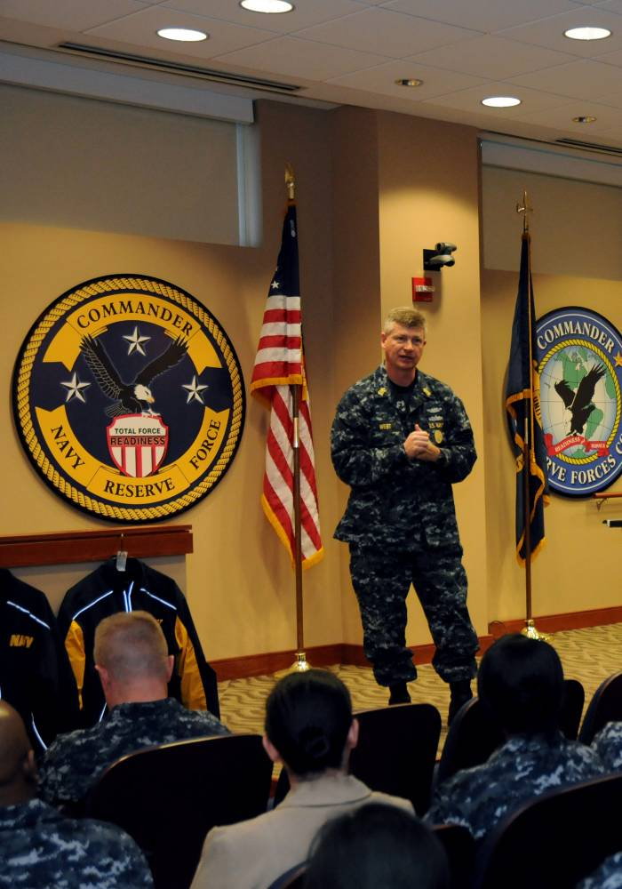
Personal Example
When leaders’ conduct is outstanding, those around them are often inspired to pattern their own actions after them, to the good of the whole organization.

Slide 47
Personal Example
Do as I Say and as I Do
Reasons to lead by personal example:
When leaders’ conduct is outstanding, those around them are often inspired to pattern their own actions after them, to the good of the whole organization
No leader can ignore the rules and regulations and still expect subordinates to follow them
If you don’t lead by personal example, you’ll lose trust, respect, and control

Slide 48
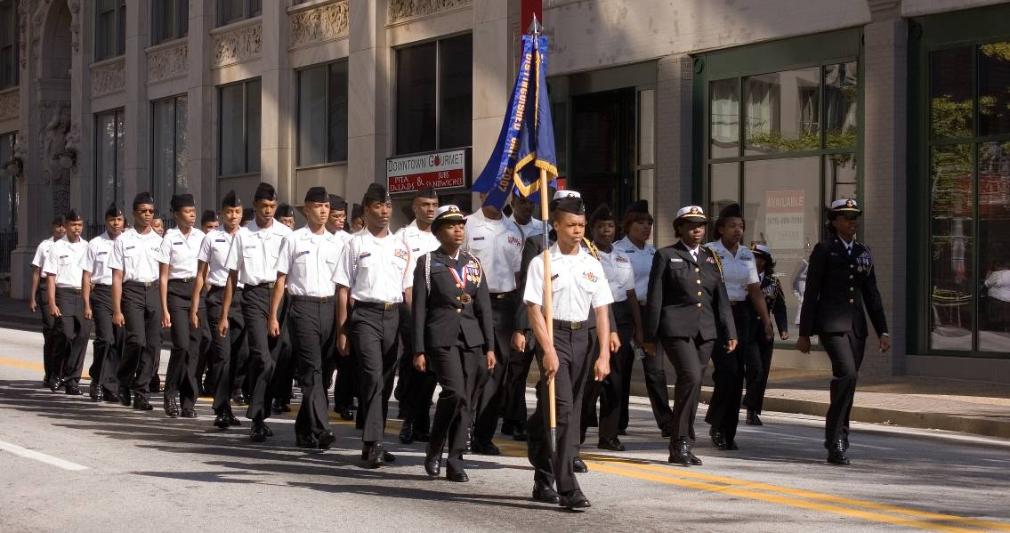
Personal Example
Honor the Uniform
No good citizen or military service member would
anything to dishonor the uniform, for such conduct can bring dishonor upon the United States and its armed forces.

Slide 49
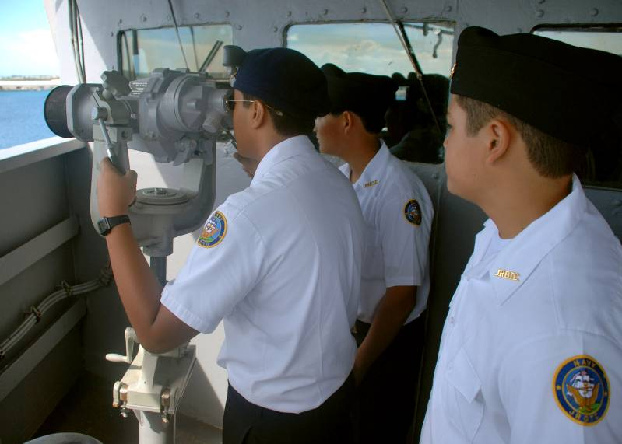
Mutual Trust and Confidence
Trust and Confidence in Subordinates
It is important to let subordinates know they are trusted. If you fail to show trust, you will be:
Constantly checking up
Distrusting records and reports
Performing your own duties less efficiently

Slide 50
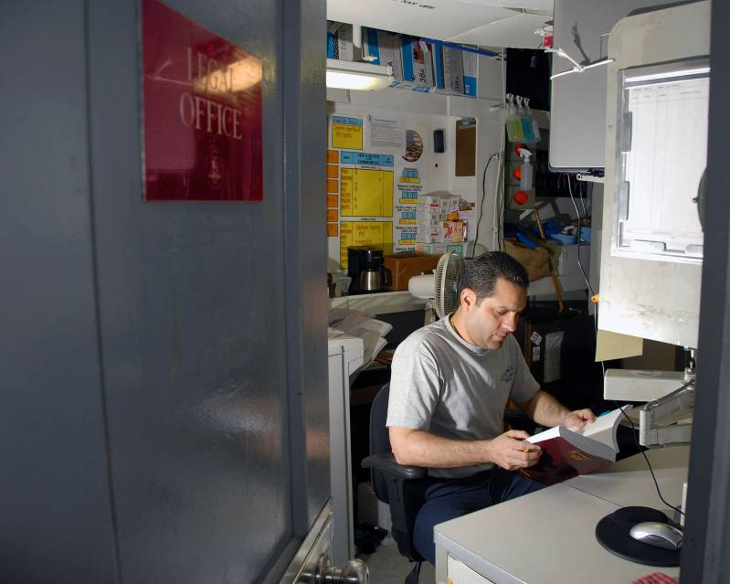
Mutual Trust and Confidence
Expectations Versus Reality
Leaders do not always do what they should, but we have a right to expect them to do what is right.
When leaders fail to fulfill their responsibilities, society has the right to:
Demand corrective action
Sometimes demand punishment under the law

Slide 51
Mutual Trust and Confidence
Jeopardizing the Organization
A leader’s reputation and the organization is jeopardized when a leader:
Fails to back subordinates
Shows favoritism
Condones dishonesty
Allows sloppy work
Evades legitimate regulations

Slide 52
Mutual Trust and Confidence
Trust, Respect, and Understanding
If you show mutual trust, respect, and understanding:
People are likely to exercise more personal responsibility
Morale will be higher
Efficiency will be improved
Burdens will be lighter

Slide 53
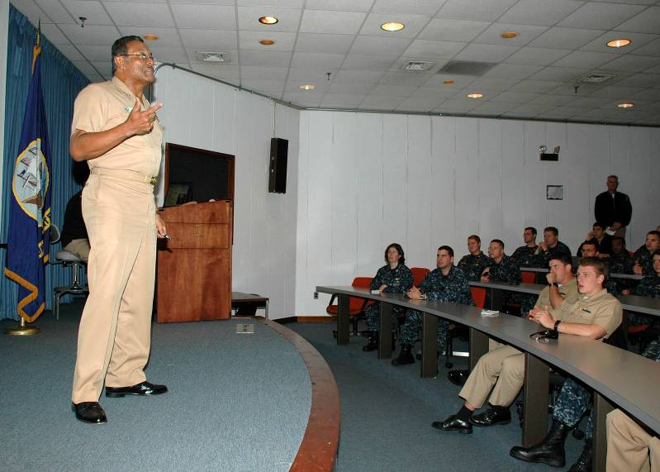
Mutual Trust and Confidence
Making and Keeping Commitments
If you don’t keep your word:
You will lose respect
Attitudes of others will be negatively affected
The organization will operate less efficiently
Never promise what cannot be delivered.

Slide 54
Discuss why decision making is important for a leader.
1.
2.
3.
Note to Instructors:
Click the Show/Hide Response Display Button

Slide 55
What would an effective leader say?
Do as I say, not as I do.
Do as I do, not as I say.
Do as I do, and as I say.
Do not do as I say, do not do as I do.
1
1
1
1
NS3-M2U1C2S1:LQ7

Slide 56
Cadet Jones holds a leadership position in his squad. He arrives at class early and prepared. During the test, another cadet asks to copy his answers. Jones explains that this is not a good idea. In this scenario, what are the traits of a good leader that he portrays? (Input all that apply, then push the ENTER button.)
Vanity
Honor
Sense of humor
Courage
Modesty
1
1
1
1
1
NS3-M2U1C2S1:LQ8

Slide 58
Leaderboard
Last
Slide
Points | Participant | Points | Participant

Slide 59
Team Scores
Last
Slide
Points | Team | Points | Team

Slide 60
Team MVP
Last
Slide
Points | Team | Participant

Slide 61
Whiteboard
Last
Slide

